Slide 1
Data Mining Topic: Evaluating Classifier Performance
Dr. J Angel Arul Jothi
Department of Computer Science

Slide 2
Text Book Chapter 4

Slide 3
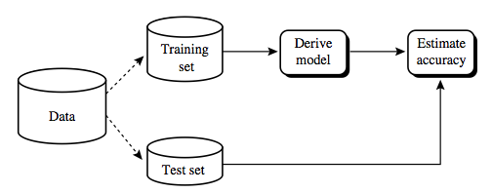
Evaluating the Performance of a Classifier
Classifiers are learned (trained) on a finite training data
A learned classifier has to be tested on a different test set experimentally
The performance of classifiers on test data shows the generalization capability

Slide 4
Evaluating the Performance of a Classifier
Methods
Hold out
Random subsampling
Cross validation
Boostrap

Slide 5
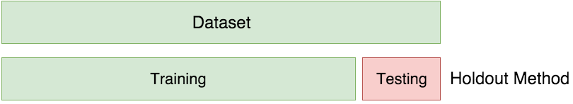
Hold out method
The data is randomly partitioned into two disjoint sets
Training set (2/3) for learning the classifier and Testing set (1/3) for classifier accuracy evaluation

Slide 6
Random Subsampling
The holdout method can be repeated several times to improve the estimation of a classifier’s performance
Let acc_{i} be the model accuracy during the i^{th} iteration
The overall accuracy is given by
Disadvantage
It has no control over the number of times each record is used for testing and training
Consequently, some records might be used for training more often than others

Slide 7
K-fold cross validation
Each record is used the same number of times for training and exactly once for testing
Partition dataset into k equal sized “folds”
Train on k-1 folds
Test on one remaining fold
Repeat the process for k times. Each time select a fold that has not been selected for testing so far.
In the extreme (n=k) this is known as “leave-one-out” cross validation

Slide 8
Cross-validation visualized
Available Labeled Data
Identify k folds
Iteration 1
Train
Train
Train
Train
Train
Test

Slide 9
Cross-validation visualized
Available Labeled Data
Identify n partitions
Iteration 2
Test
Train
Train
Train
Train
Train

Slide 10
Cross-validation visualized
Available Labeled Data
Identify n partitions
Iteration 3
Train
Test
Train
Train
Train
Train

Slide 11
Cross-validation visualized
Available Labeled Data
Identify n partitions
Iteration 4
Train
Train
Test
Train
Train
Train

Slide 12
Cross-validation visualized
Available Labeled Data
Identify n partitions
Iteration 5
Train
Train
Train
Test
Train
Train

Slide 13
Cross-validation visualized
Available Labeled Data
Identify n partitions
Iteration 6
Train
Train
Train
Train
Test
Train
Calculate Average Performance

Slide 14
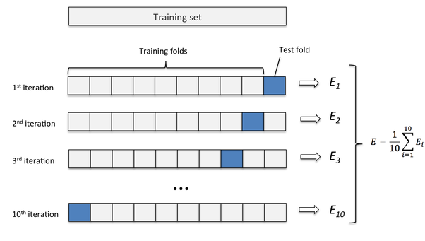
Leave-one-out
A special case of K-fold cross validation with K=n, where n is the total number of samples in the training set.
n experiments are performed using n−1 samples for training and the remaining sample for testing.

Slide 15
Bootstrap
The training records are sampled with replacement
A record already chosen for training is put back into the original pool of records so that it is equally likely to be redrawn
Records that are not included in the bootstrap sample become part of the test set
The model induced from the training set is then applied to the test set to obtain an estimate of the accuracy of the bootstrap sample
The sampling procedure is then repeated b times to generate b bootstrap samples

Slide 16

Bootstrap
Overall accuracy of the classifier (.632 bootstrap)
Combining the accuracies of each bootstrap sample
accuracy computed from a training set that contains all the labeled examples in the original data (acc_{s})

Slide 17
Thank you

